Slide 1
Olay 419爱的告白 GA检测代码

Slide 2
爱的告白
全站监测代码：
<script>
(function(i,s,o,g,r,a,m){i['GoogleAnalyticsObject']=r;i[r]=i[r]||function(){
(i[r].q=i[r].q||[]).push(arguments)},i[r].l=1*new Date();a=s.createElement(o),
m=s.getElementsByTagName(o)[0];a.async=1;a.src=g;m.parentNode.insertBefore(a,m)
})(window,document,'script','https://www.google-analytics.com/analytics.js','ga');
ga('create', 'UA-65644566-16', 'auto');
ga('send', 'pageview');
</script>

Slide 3

爱的告白
Event Parameter | Value
Event Category | Apply
Event Action | Apply
Event Label | Click

Slide 4
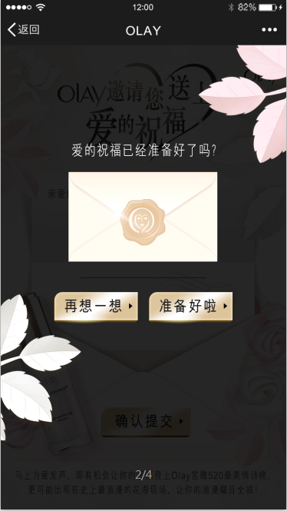
爱的告白
Event Parameter | Value
Event Category | submit
Event Action | {name}
Event Label | Click
Try again
submit

